Slide 1


JEPPIAAR ENGINEERING COLLEGE
SB FOOD ORDERING APP
TEAM LEADER: BHARATH.M (310821104017) TEAM MEMBER 1: KAARTHIKEY.G (310821104045) TEAM MEMBER 2: KATHIRGAMAN.M (310821104047) TEAM MEMBER 3: JESHU DENZIL DEVE.M (310821104040) | SUPERVISOR NAME: MRS.D.JEEVITHA .M.E ASSISTANT PROFESSOR /CSE

Slide 2
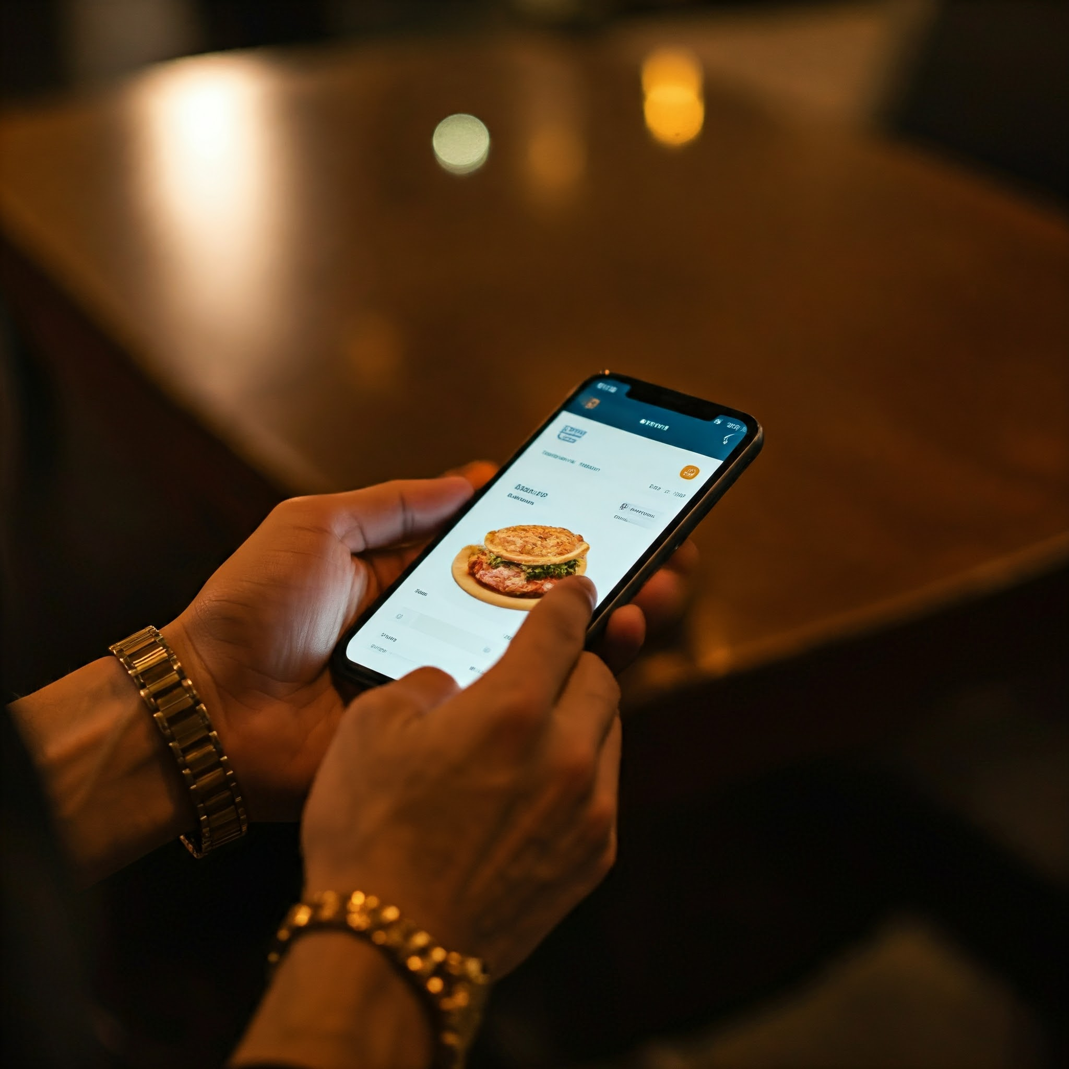
Introduction
“SB FOOD ORDERING APP” is an app which is used to order our favorite food from our favorite restaurant from our home.

Slide 3




Meet the Team
Bharath
Kaarthikey
Kathirgaman
Jeshu Denzil Deve
Team leader and front-end developer
Back-end developer
Database developer
Project manager and tester

Slide 4


PROJECT OVERVIEW
Purpose:
Simplifies and streamlines the food ordering and delivery process.
Connects customers with a wide range of restaurants and their menus.
Allows users to browse and search for food items easily.
Facilitates seamless order placement and payment.
Provides order status checking for customers.
Offers an admin panel for restaurant managers to handle orders and menu updates.
Features of the app:
User Registration and Authentication
User roles and permissions
Browse and search menus
Add to cart and place orders
Order management and Tracking
Admin Panel
User Profile Management

Slide 5




Architecture
Front End
Back End
Database
React (UI)
Express JS | Node JS
MongoDB

Slide 6
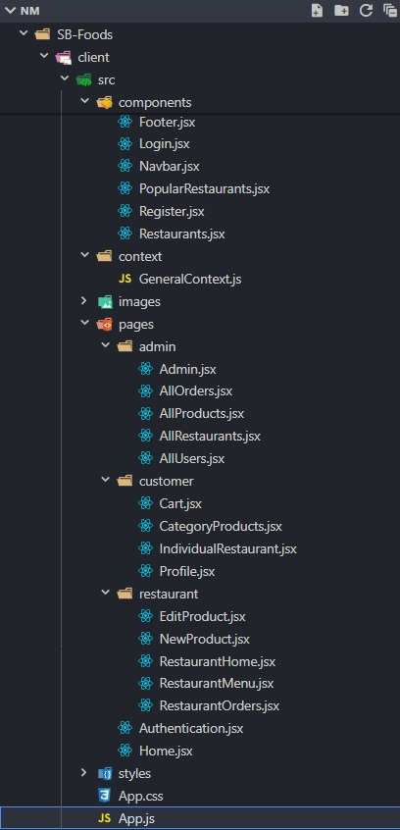
Client Folder Structure

Slide 7
Now let's understand the Front-End of the Application
React:
A JavaScript library for building user interfaces, allowing developers to create reusable components and efficiently update the UI based on changes in data.
React Hooks:
These are the functions in React (e.g., useState, useEffect) that allow developers to manage state and side effects in functional components.
Context API:
A feature in React used for managing global state, enabling data sharing between components without the need for prop drilling.
React Router:
A library for React that enables navigation between different pages or views, allowing the creation of single-page applications with dynamic routing.
Bootstrap:
A popular CSS framework that simplifies responsive and modern web design by providing pre-designed components and utility classes.
Axios:
A promise-based JavaScript library used to make HTTP requests, simplifying API calls and handling responses in both frontend and backend applications.
React Icons:
A library of ready-to-use icons compatible with React, offering a wide range of customizable icons from popular icon packs.

Slide 8
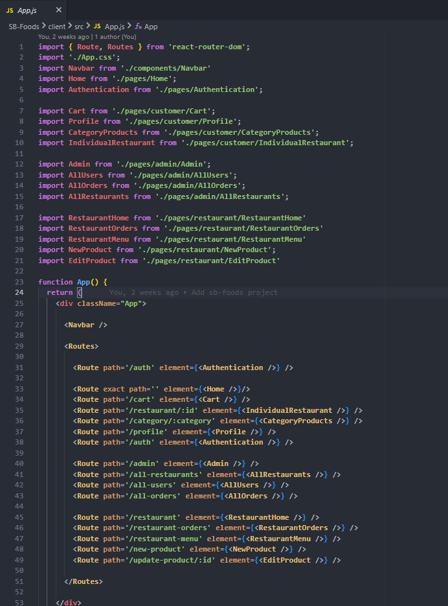
App.js

Slide 9

Setup Instructions
Pre-Requisite:
To develop a full stack food ordering app using React JS, Node.js, and MongoDB, there are several prerequisites you should consider. Here are the key prerequisites for developing such an application:
Node.js and npm: Install Node.js, which includes npm (Node Package Manager), on your development machine. Node.js is required to run JavaScript on the server side.
MongoDB: Set up a MongoDB database to store hotel and booking information. Install MongoDB locally or use a cloud-based MongoDB service.
Express.js: Express.js is a web application framework for Node.js. Install Express.js to handle client-side routing, middleware, and API development.
React.js: React.js is a popular JavaScript library for building user interfaces. It enables developers to create interactive and reusable UI components, making it easier to build dynamic and responsive web applications.
HTML, CSS, and JavaScript: Basic knowledge of HTML for creating the structure of your app, CSS for styling, and JavaScript for client-side interactivity is essential.
Database Connectivity: Use a MongoDB driver or an Object Document Mapping (ODM) library like Mongoose to connect your Node.js server with the MongoDB database and perform CRUD (Create, Read, Update, Delete) operations.
Version Control: Use Git for version control, enabling collaboration and tracking changes throughout the development process. Platforms like GitHub or Bitbucket can host your repository.

Slide 10
Setup Instructions
Development Environment: Choose a code editor or Integrated Development Environment (IDE) that suits your preferences, such as Visual Studio Code, Sublime Text, or WebStorm.
To Connect the Database with Node JS go through the below provided link:
Link: https://www.section.io/engineeringeducation/nodejs mongoosejs-mongodb/
To run the existing SB Foods App project downloaded from GitHub:
Follow below steps:
Clone the repository:
• Open your terminal or command prompt.
• Navigate to the directory where you want to store the ecommerce app.
• Execute the following command to clone the repository:
2.Git clone: https://github.com/jeshu2003/NAANMUDHALVANFOODORDERINGAPP
3. Install Dependencies:
• Navigate into the cloned repository directory:
“cd NAANMUDHALVANFOODORDERINGAPP”
• Install the required dependencies by running the following command:
“npm install”
4. Start the Development Server:
• To start the development server, execute the following command:
“npm run dev” or “npm run start”
• The ecommerce app will be accessible at http://localhost:3000 by default. You can change the port configuration in the .env file if needed.
5. Access the App:
• Open your web browser and navigate to http://localhost:3000.
• You should see the flight booking app's homepage, indicating that the installation and setup were successful

Slide 11
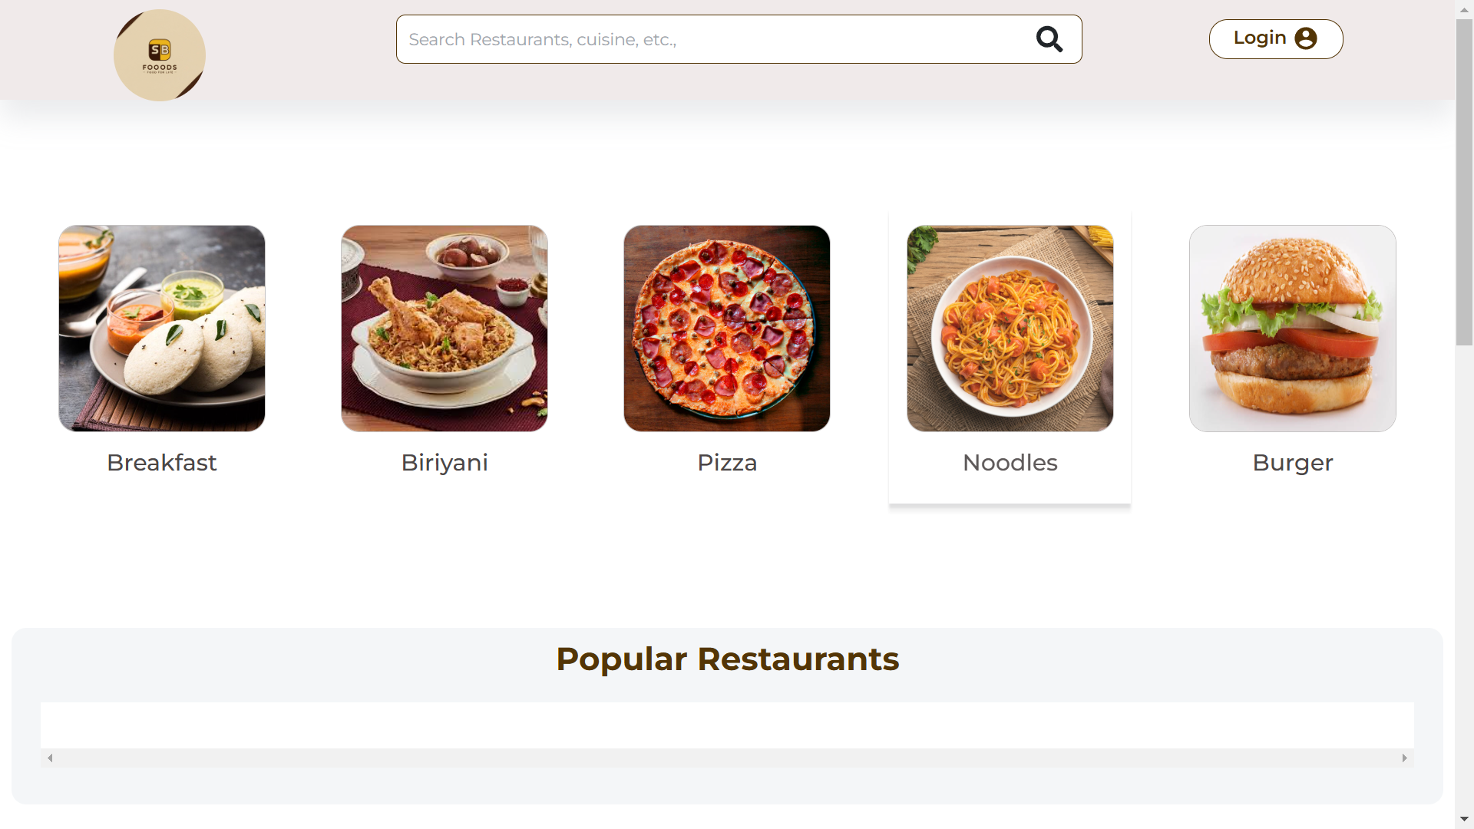
FRONT-END AND OVERALL PROJECT FLOW

Slide 12
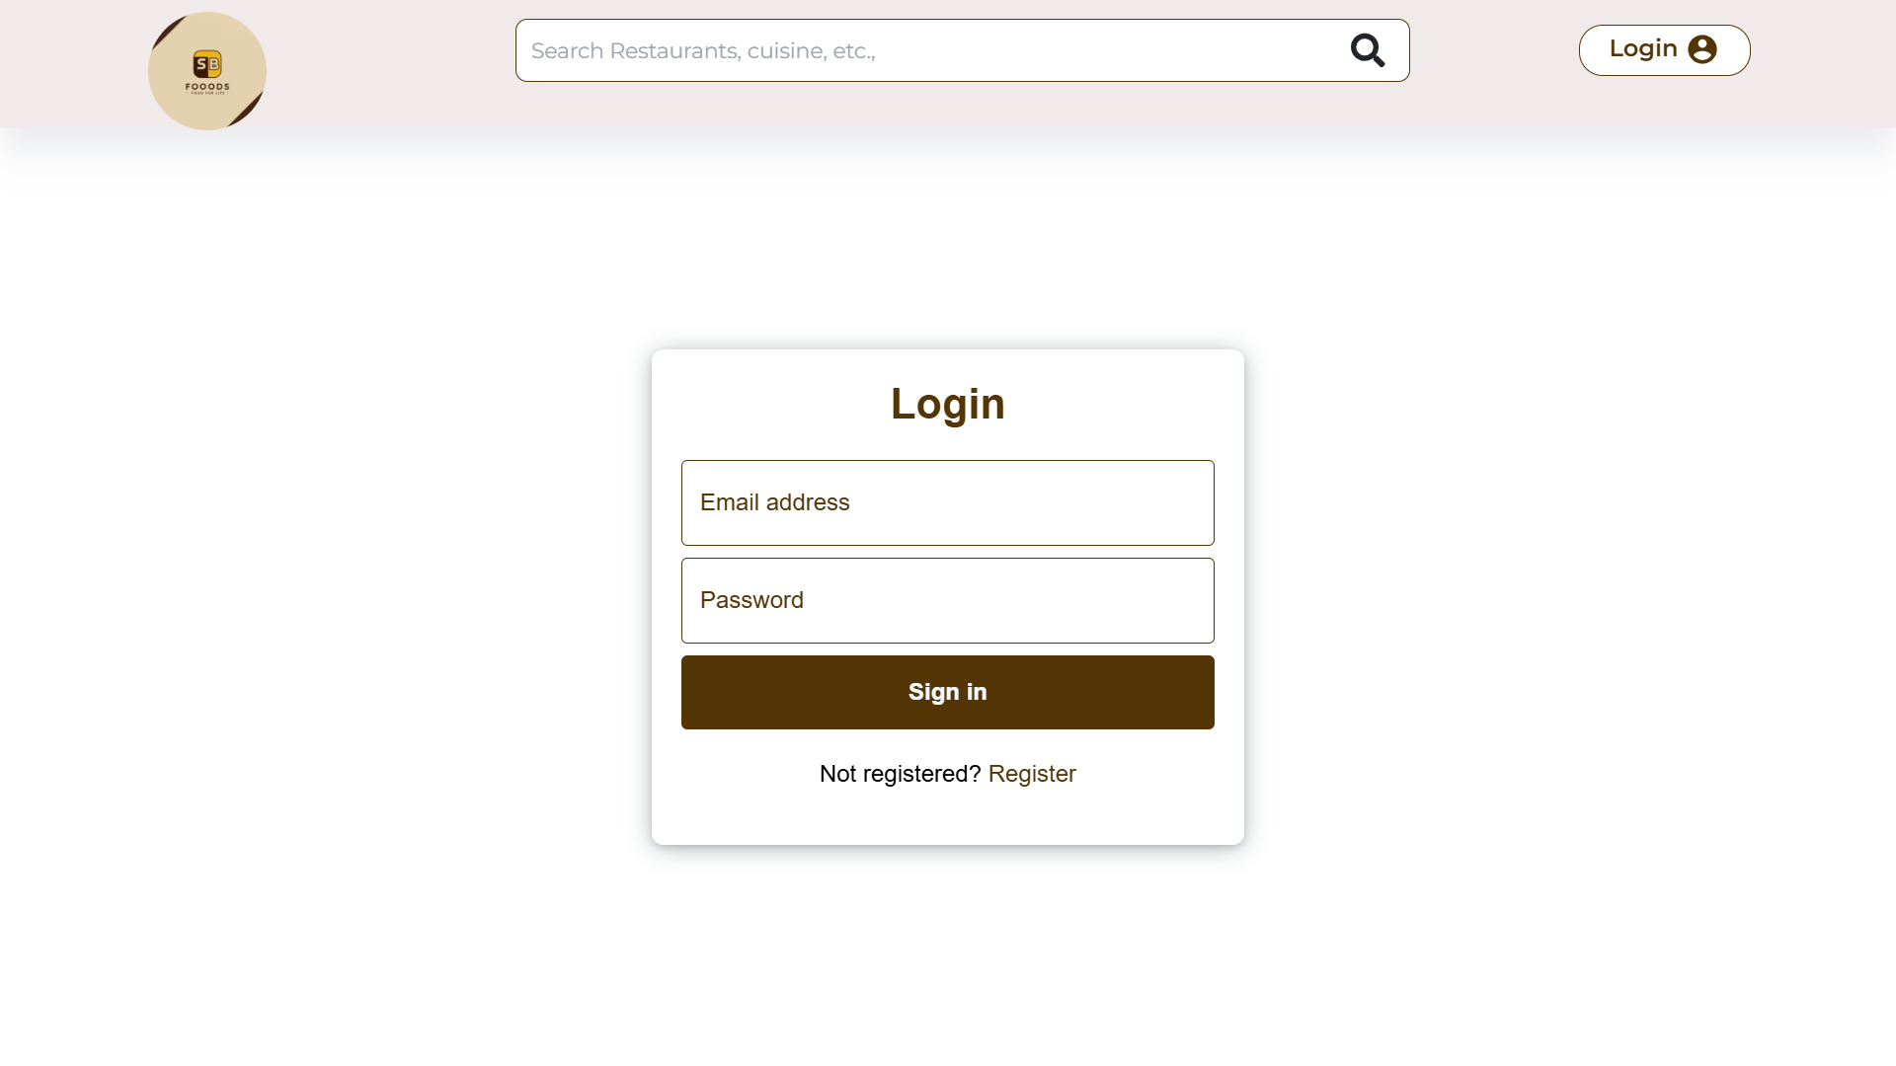
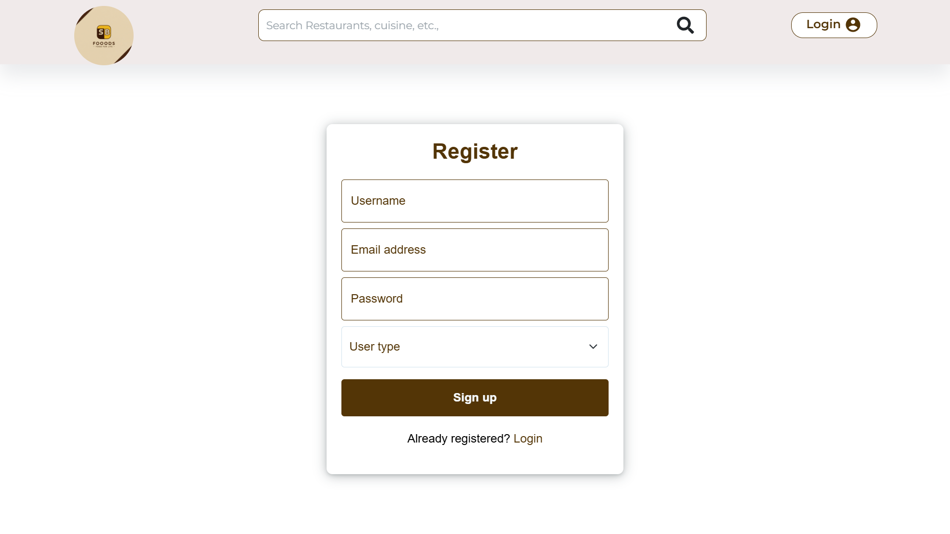

Slide 13
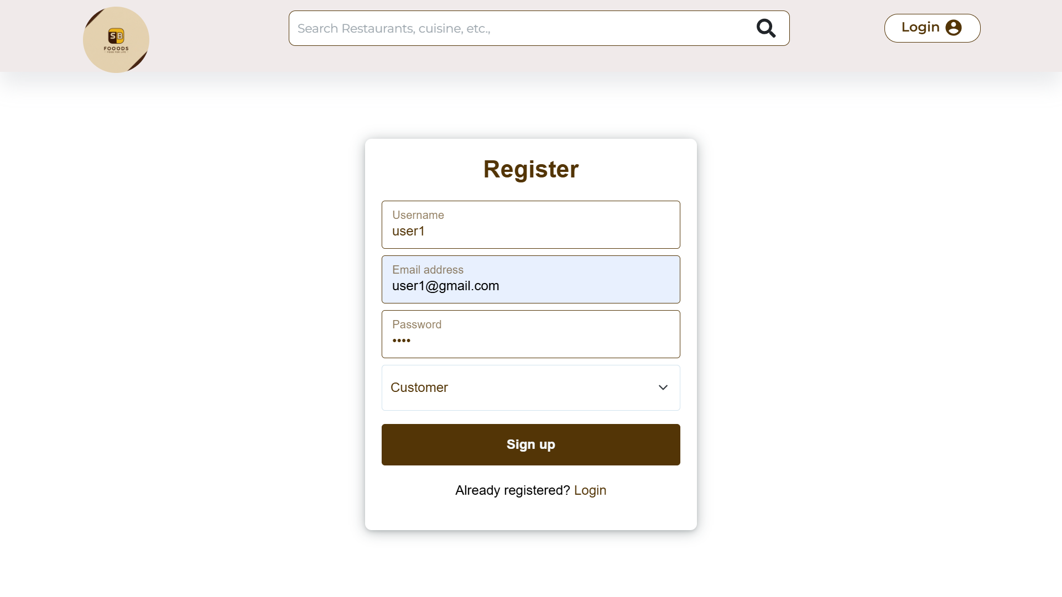
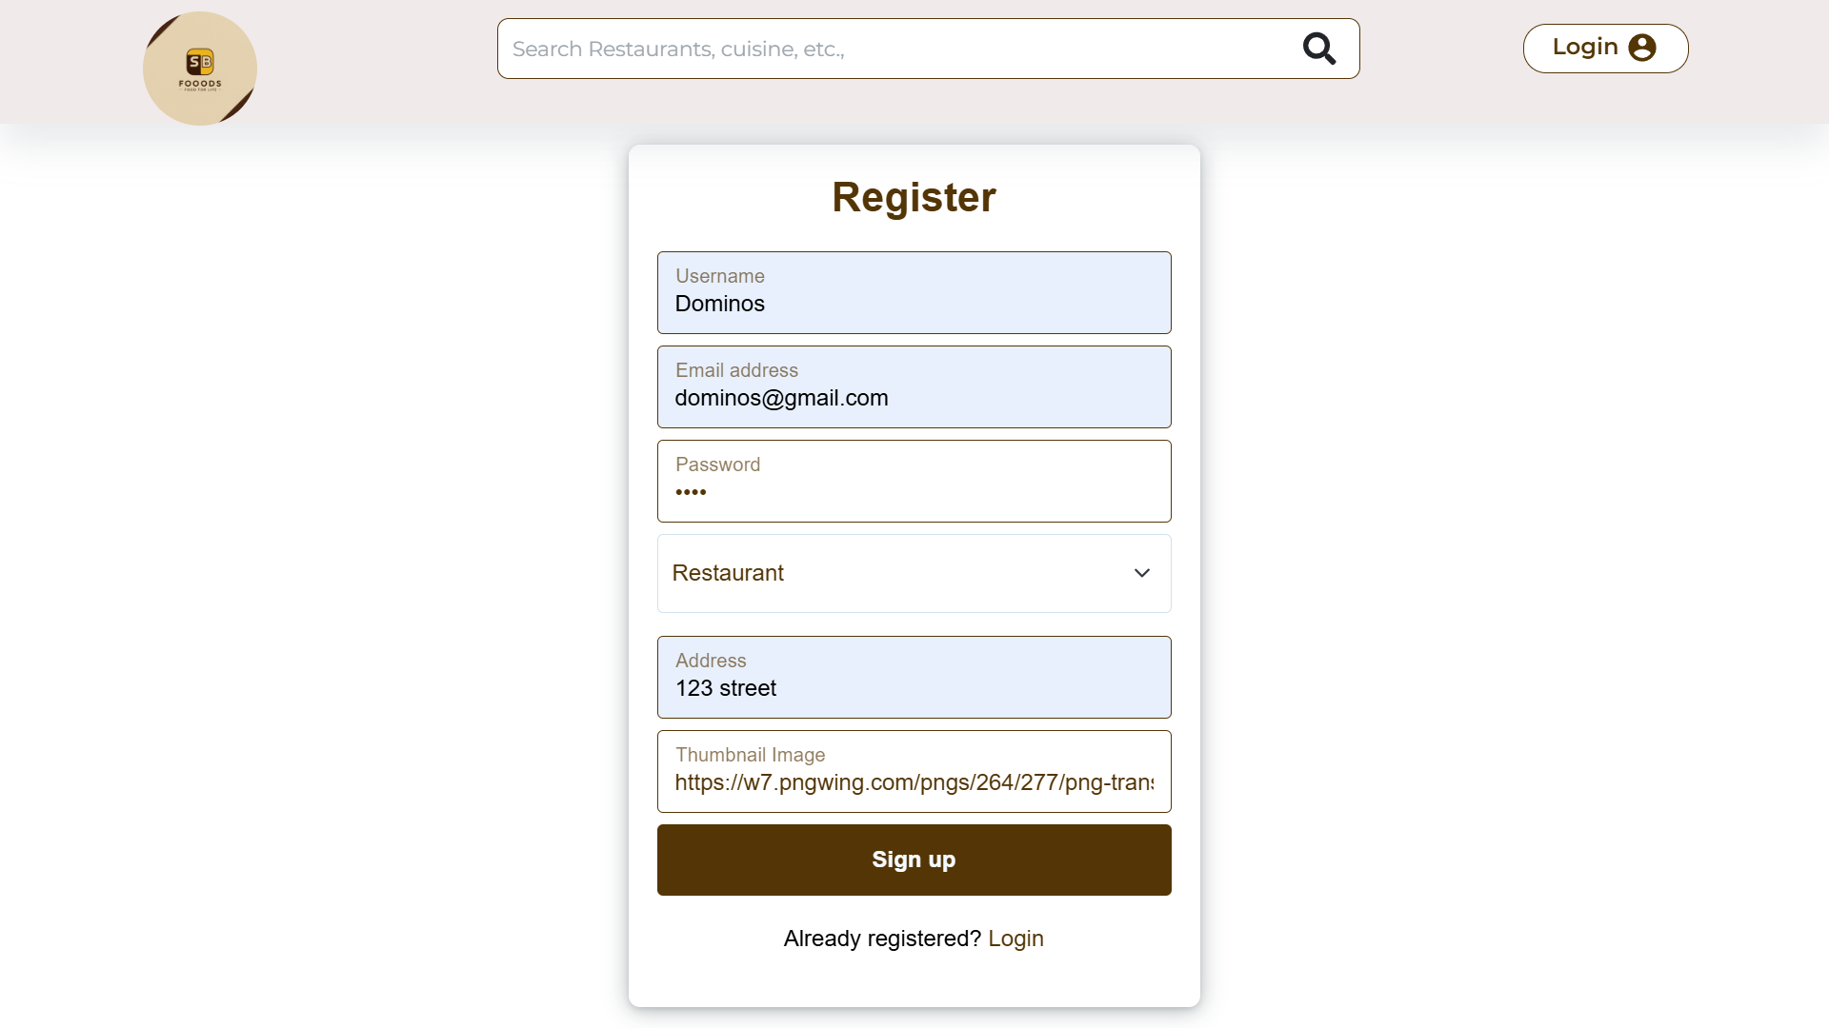

Slide 14
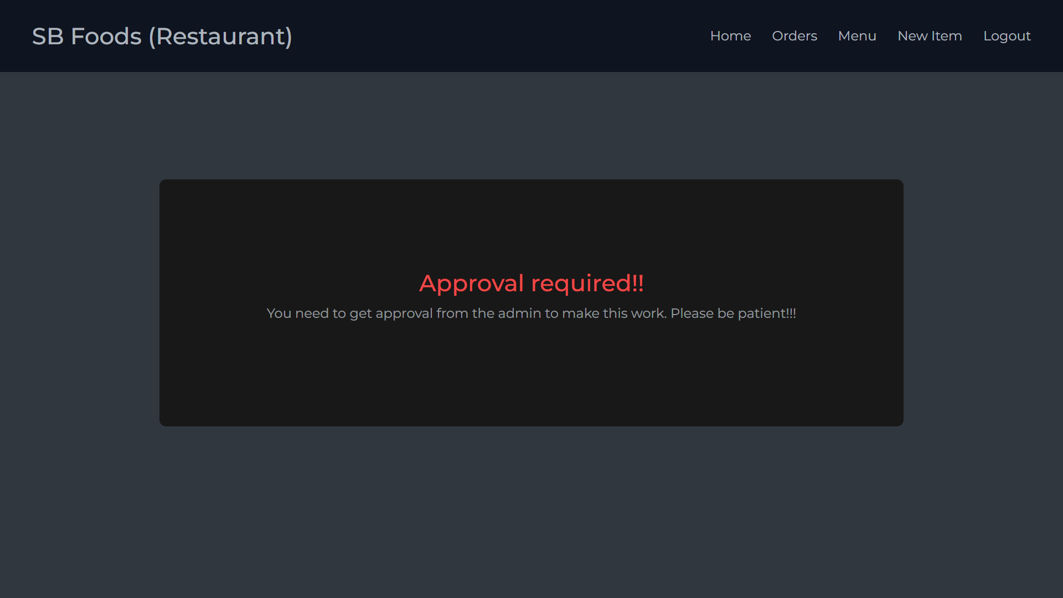
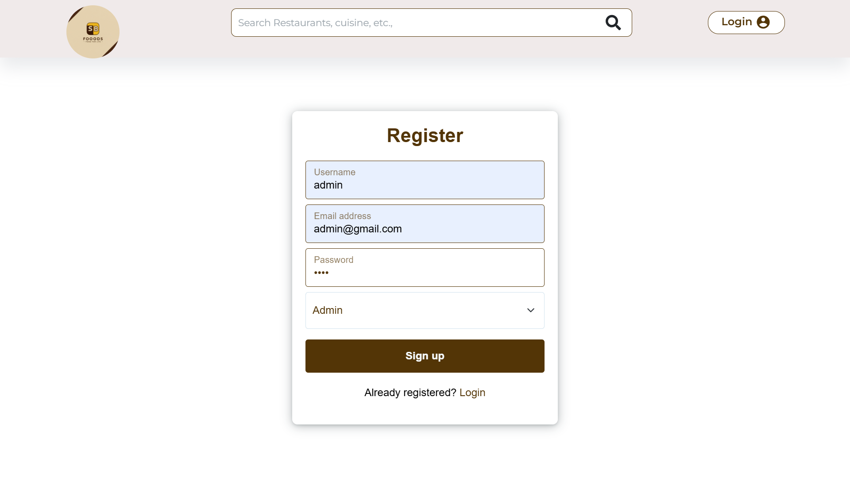

Slide 15
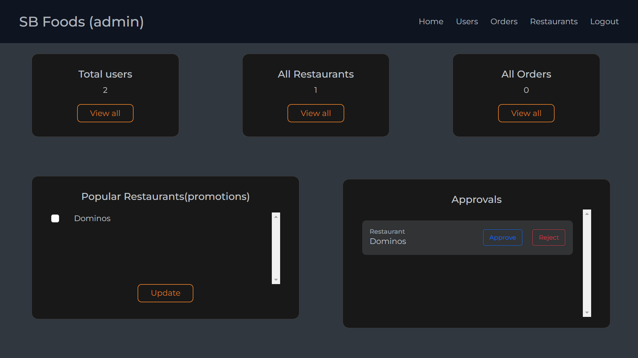
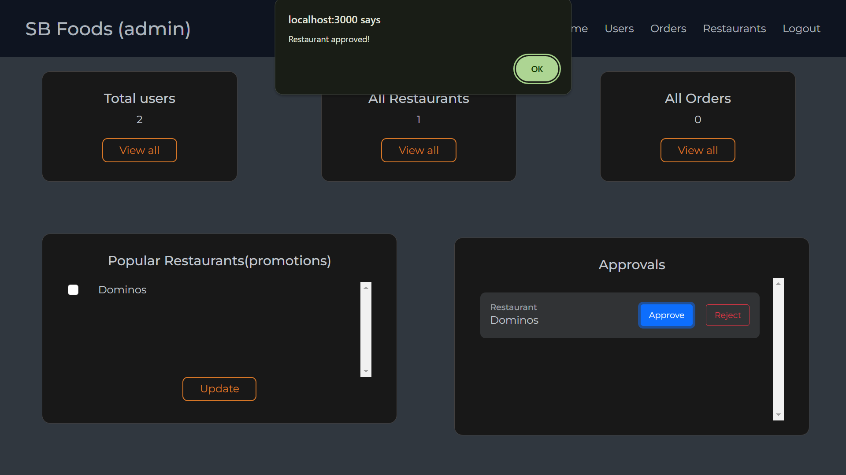

Slide 16
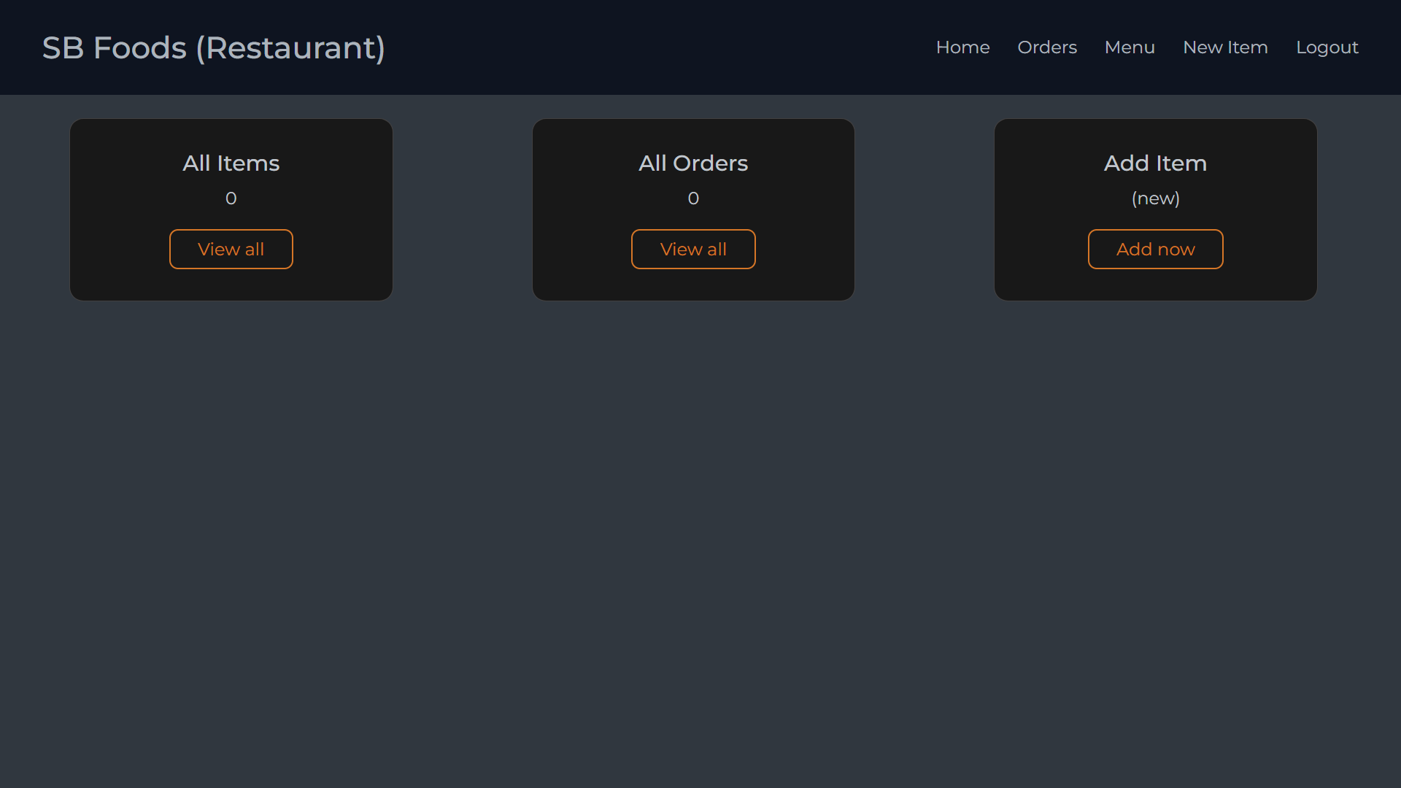
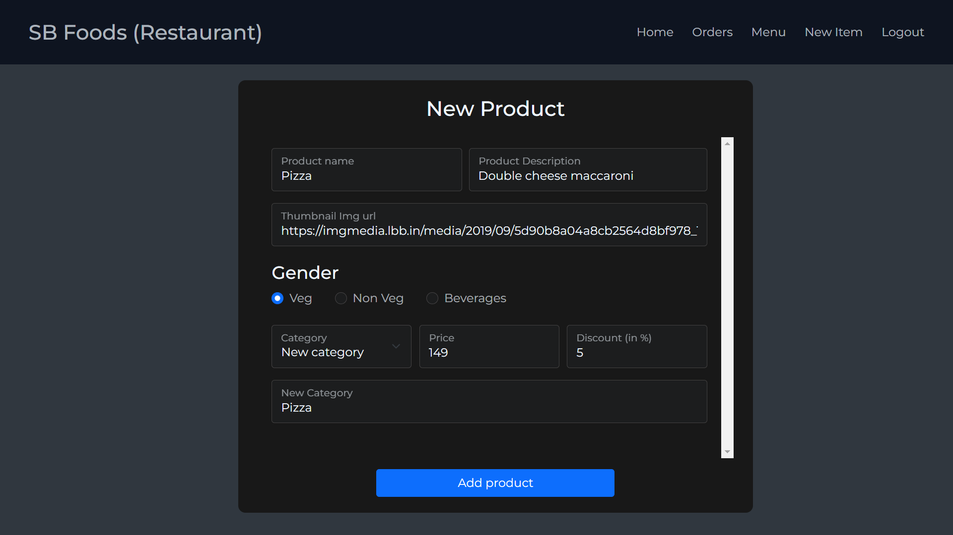

Slide 17
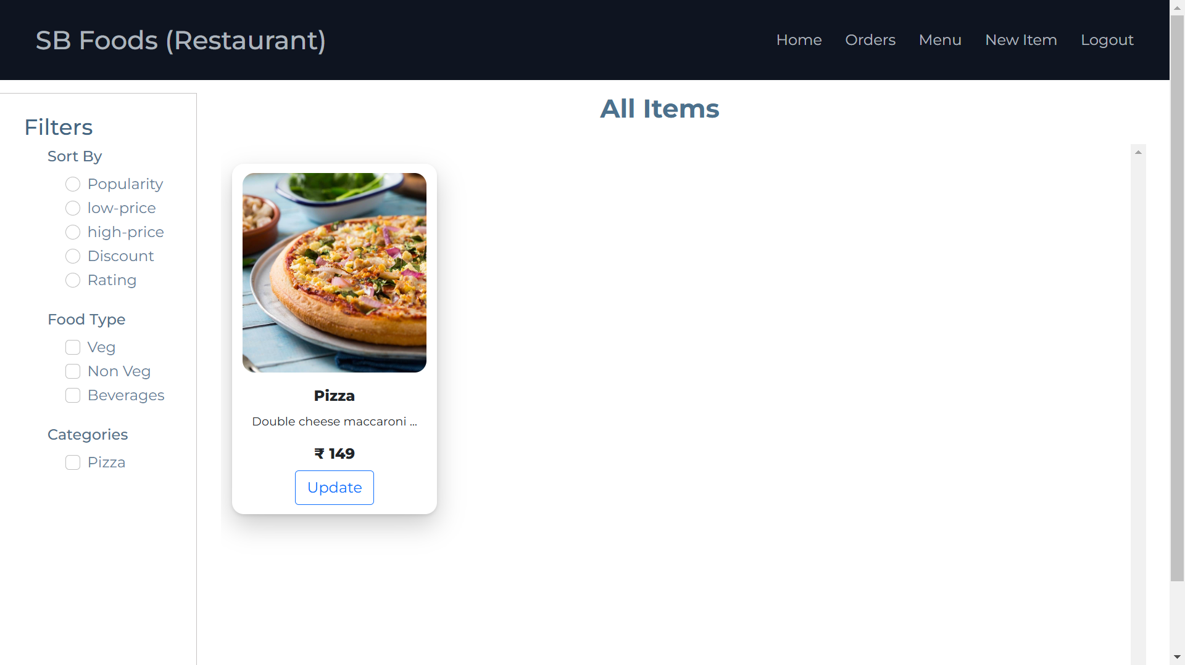
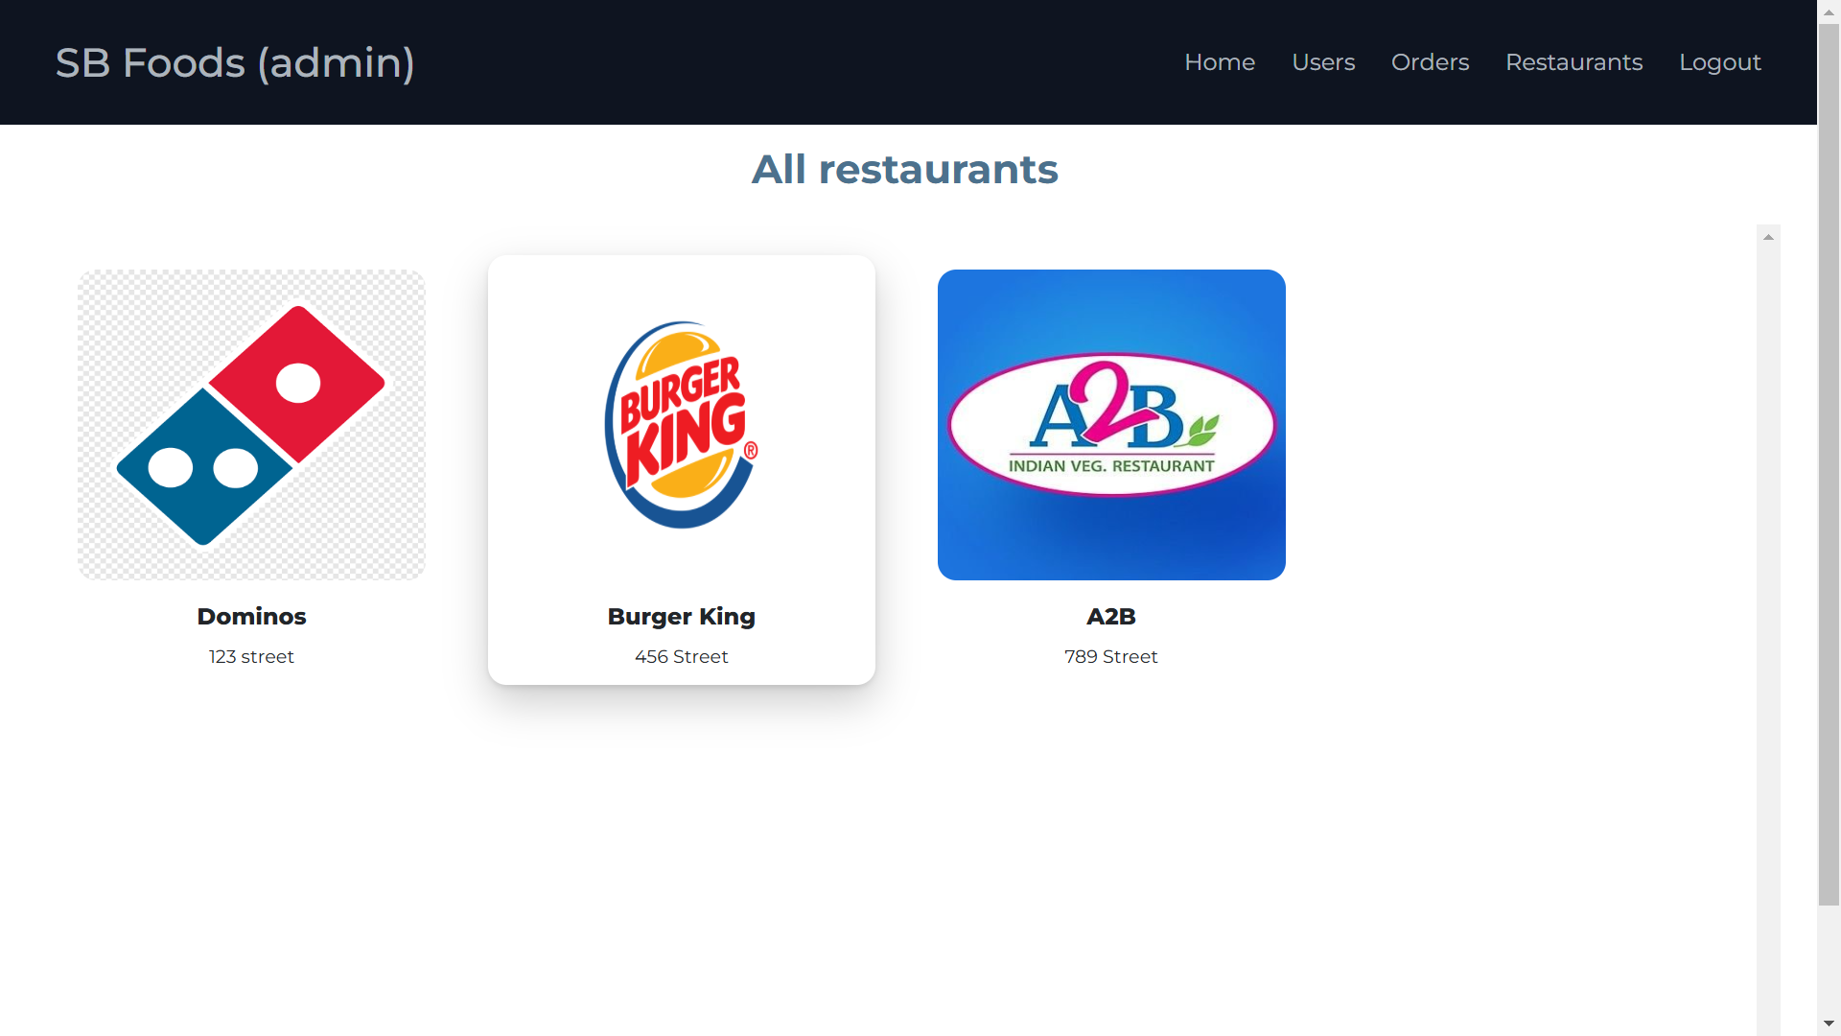

Slide 18
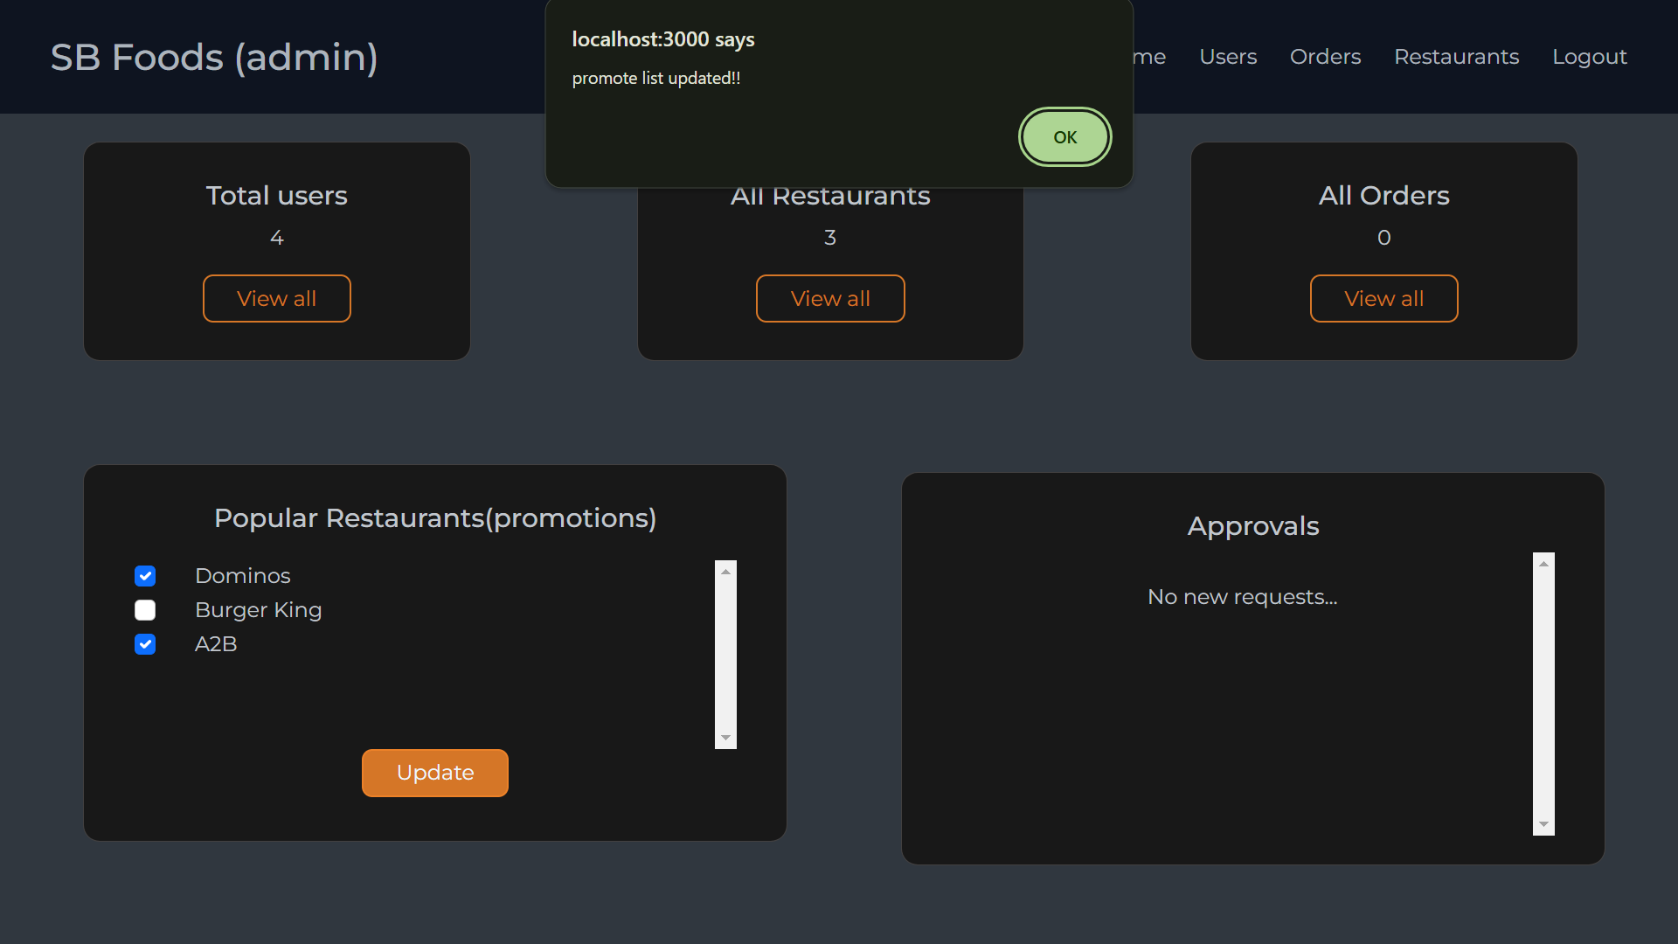
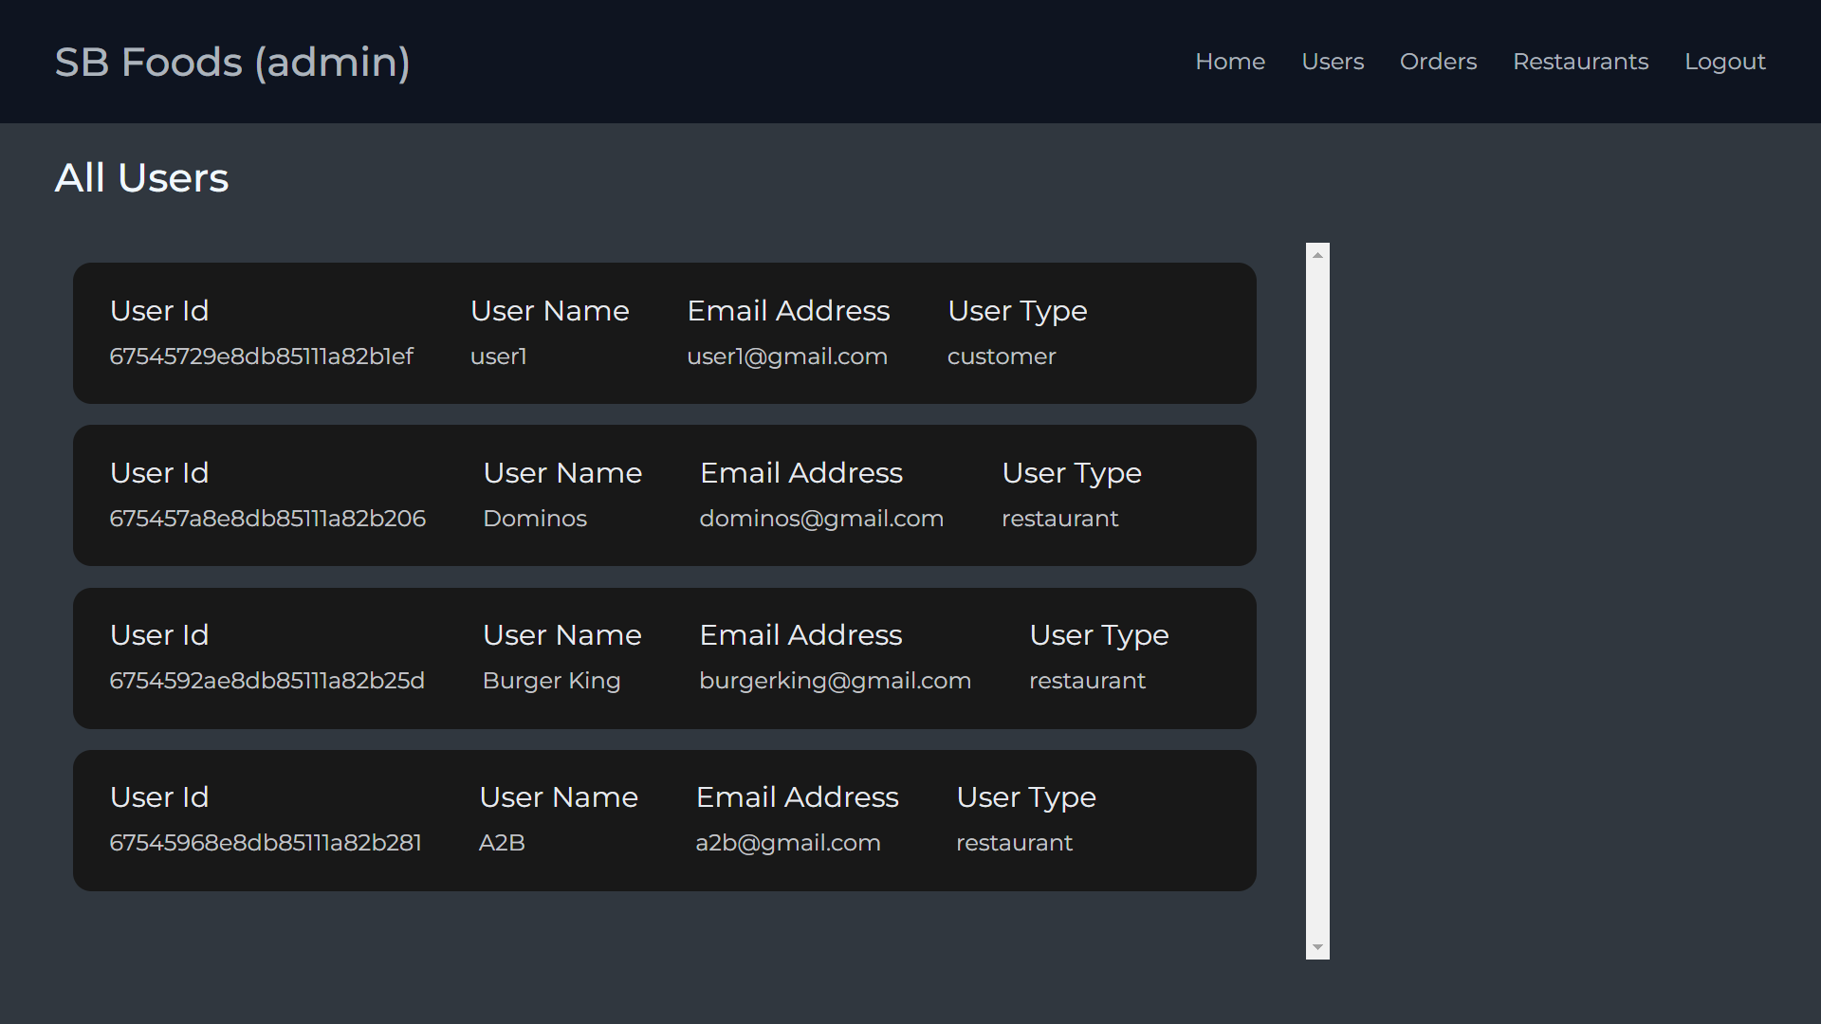

Slide 19
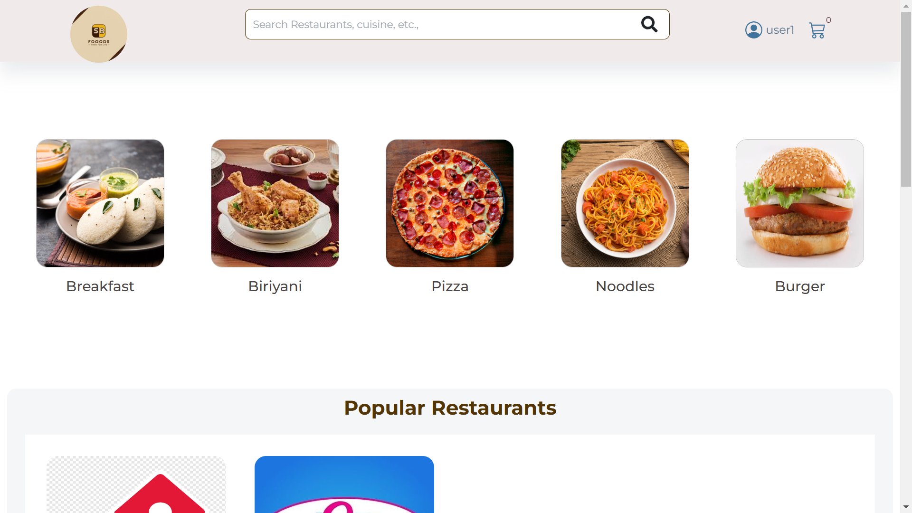
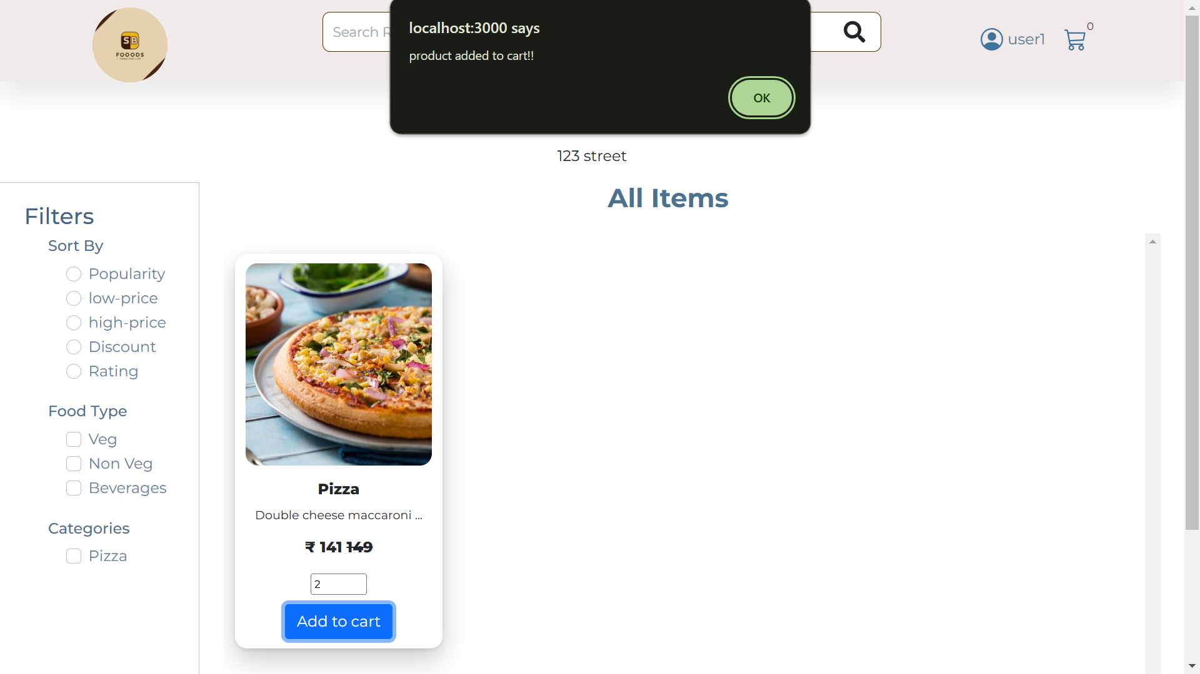

Slide 20
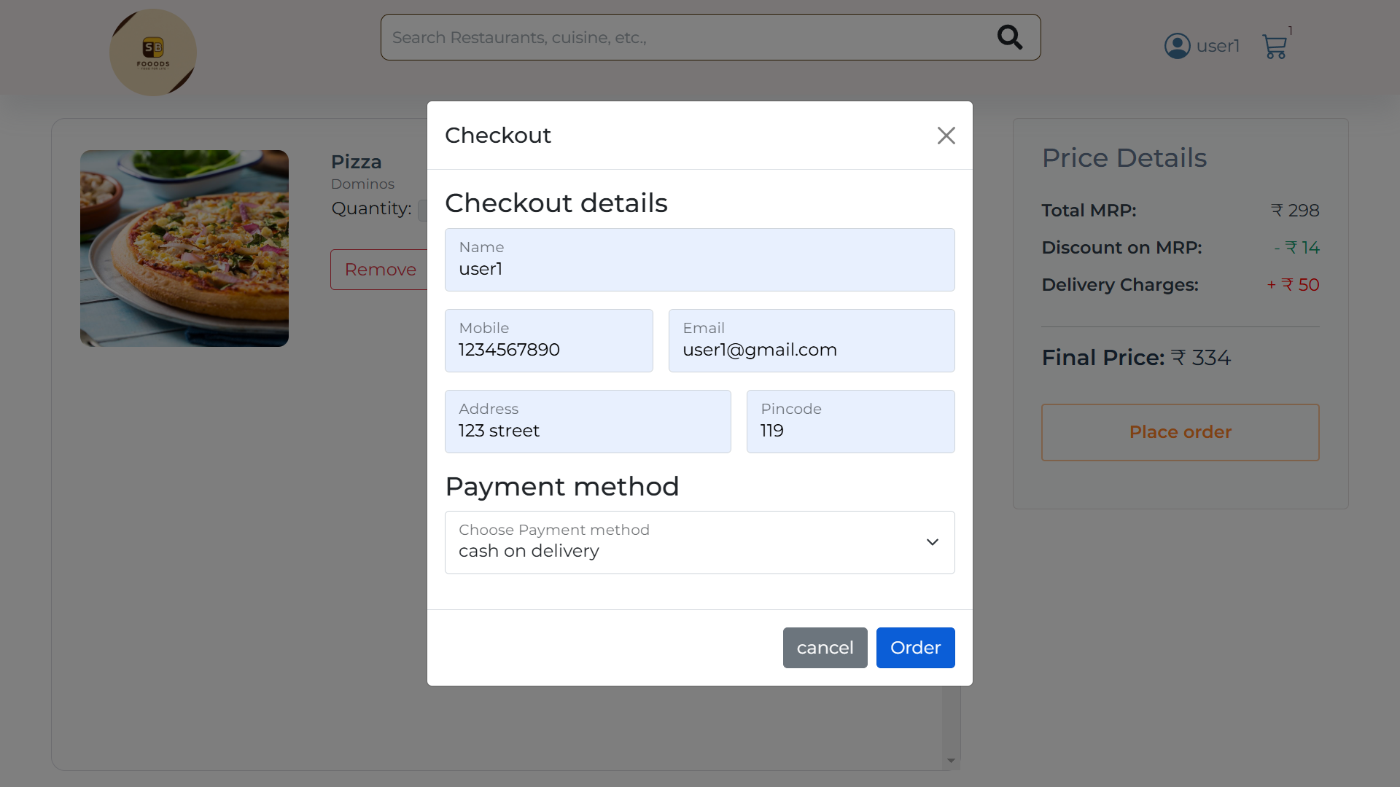
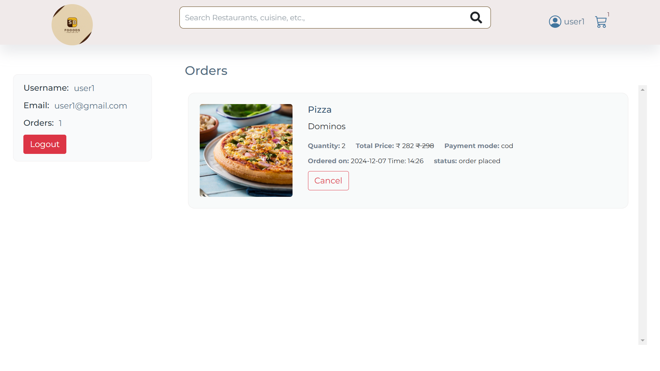

Slide 21
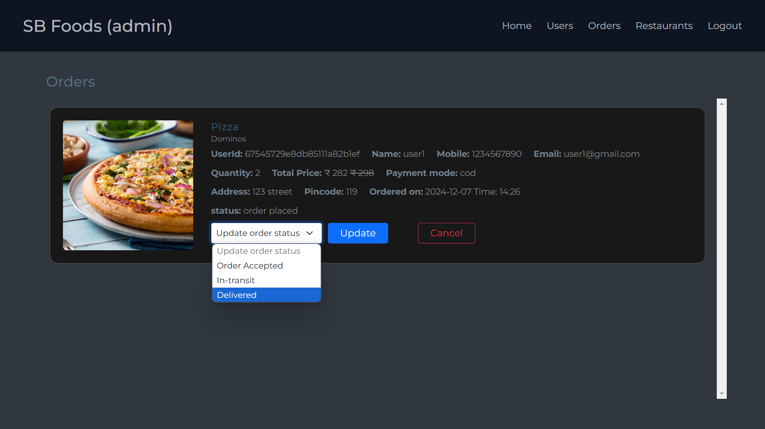
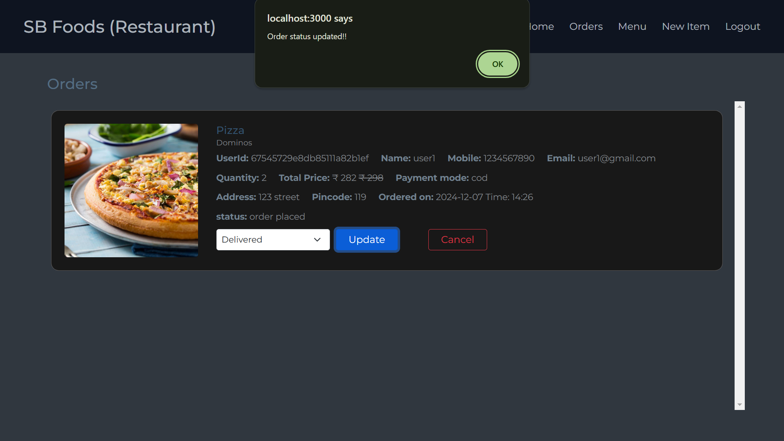

Slide 22


Slide 23
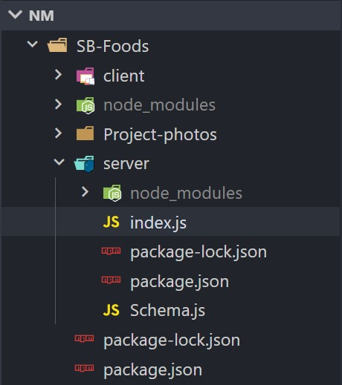
Server Folder Structure

Slide 24
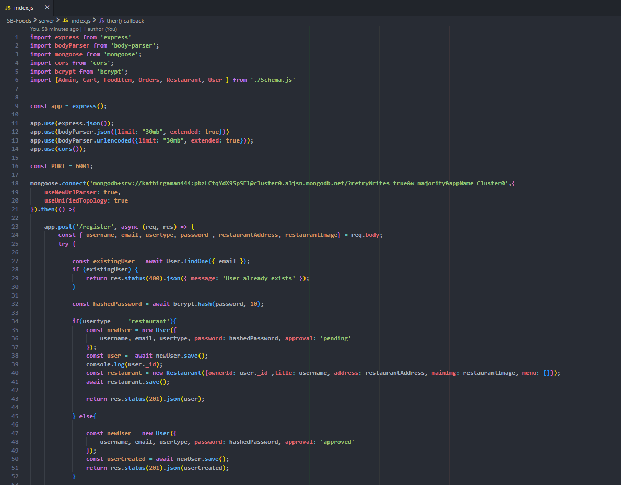
Index.js

Slide 25
Now let's understand the Server-side code for the Application
1. Overview
Purpose: Backend server for a food delivery application.
Technologies Used:
Express.js: For building the server and handling API routes.
MongoDB + Mongoose: For database management and schema definition.
bcrypt: For secure password hashing.
CORS: To allow cross-origin requests.
2. Application Setup
Port: Server runs on port 6001.
Database Connection:
Connects to a local MongoDB instance at mongodb://localhost:6001/foodDelivery.
Uses Mongoose to simplify interaction with the database.

Slide 26
3. Key Features and Endpoints
Authentication
POST /register:
Registers users (customers or restaurants).
Hashes passwords using bcrypt.
Handles approval status for restaurants.
POST /login:
Verifies email and password using bcrypt.
User Management
GET /fetch-user-details/:id: Fetches user details by ID.
GET /fetch-users: Lists all users.
Restaurant Management
GET /fetch-restaurants: Fetches all restaurants.
POST /approve-user / POST /reject-user: Approves or rejects restaurant accounts.
GET /fetch-restaurant-details/:id: Fetches details of a restaurant by owner ID.
Food Item Management
POST /add-new-product: Adds a new food item.
PUT /update-product/:id: Updates food item details.
GET /fetch-items: Fetches all food items.

Slide 27
Order Management
POST /place-cart-order: Places an order from cart items.
PUT /cancel-order: Cancels an order.
PUT /update-order-status: Updates the status of an order.
GET /fetch-orders: Fetches all orders.
Cart Operations
POST /add-to-cart: Adds a food item to the cart.
GET /fetch-cart: Fetches all items in the cart.
PUT /remove-item: Removes an item from the cart.
Admin Features
POST /update-promote-list: Updates the promoted restaurants list.
GET /fetch-promoted-list: Fetches the promoted restaurants list.
GET /fetch-categories: Fetches or initializes food categories.
4. Security and Error Handling
Password Security: Passwords are hashed using bcrypt.
Error Handling: All routes include try-catch blocks for error management.
Default Middleware:
Handles JSON and URL-encoded data.
Allows cross-origin requests with CORS.

Slide 28
Packages involved in the server:
The following packages are used in the code and play a crucial role in building the backend server for the food delivery application:
1. express
Purpose: Framework for building web applications and APIs in Node.js.
Usage in Code:
Simplifies route handling (e.g., app.post, app.get).
Middleware integration for request handling.
Why Important: Provides a robust structure for the server.
2. body-parser
Purpose: Parses incoming request bodies (JSON or URL-encoded) and makes them accessible in req.body.
Usage in Code:
app.use(bodyParser.json({limit: "30mb", extended: true})): Parses JSON payloads up to 30MB.
app.use(bodyParser.urlencoded({limit: "30mb", extended: true})): Parses URL-encoded data.
Why Important: Ensures that request payloads are processed correctly, especially for APIs handling large data.

Slide 29
3. mongoose
Purpose: Object Data Modeling (ODM) library for MongoDB and Node.js.
Usage in Code:
Schema Definitions: Models like User, Restaurant, Orders are defined in Schema.js.
Database Connection: Connects to MongoDB using mongoose.connect.
CRUD Operations: Perform operations such as find, save, and deleteOne on collections.
Why Important: Abstracts MongoDB queries into a more developer-friendly format.
4. cors
Purpose: Enables Cross-Origin Resource Sharing (CORS) for APIs.
Usage in Code:
app.use(cors()): Allows the frontend (potentially on a different domain) to make requests to the backend server.
Why Important: Ensures frontend and backend can communicate even if they are hosted on different domains or ports.

Slide 30
5. bcrypt
Purpose: Library for hashing and securely storing passwords.
Usage in Code:
bcrypt.hash(password, 10): Hashes passwords before saving to the database.
bcrypt.compare(password, user.password): Verifies hashed passwords during login.
Why Important: Critical for protecting user credentials and preventing security breaches like password leaks.
6. Custom Import: ./Schema.js
Purpose: Contains Mongoose schemas and models for User, Restaurant, Orders, etc.
Usage in Code:
Imported models like User, Admin, Cart, etc., to interact with MongoDB collections.
Why Important: Centralizes the database schema definitions, making the code modular and reusable.

Slide 31
DATABASE CONNECTION
MongoDB is a database engine that stores data in a flexible schemes and is used to work with large sets of distributed data.
Mongoose is a JS library that connects MongoDB to the Node.js Runtime Environment
Why Mongo DB over SQL?
MongoDB is a NoSQL Database ,allowing Dynamic ,JSON like documents. This is ideal for applications like food delivery whose data structure can vary(eg. Menu Items, Orders)
MongoDB is designed to handle large scale,distributed applications making it suitable for high traffic and large datasets.

Slide 32
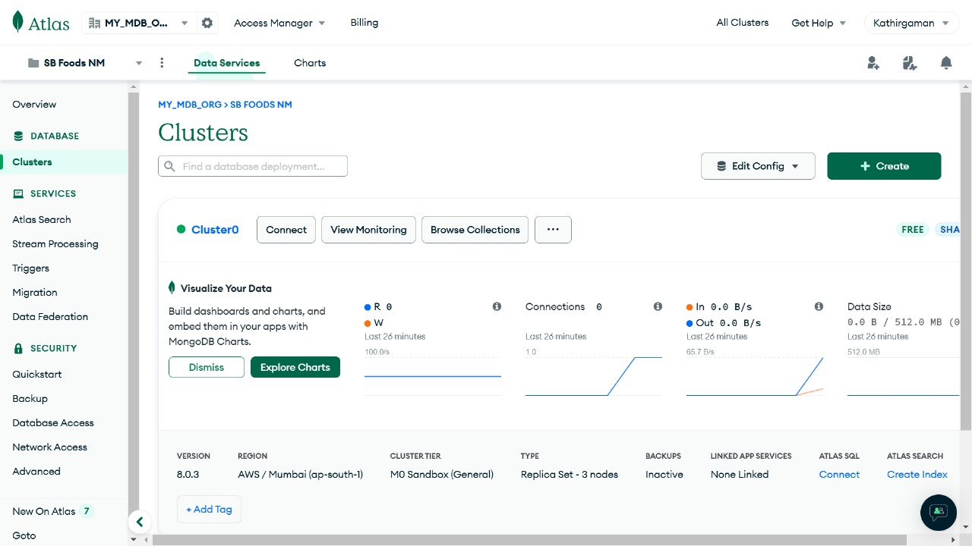
Not Connected

Slide 33
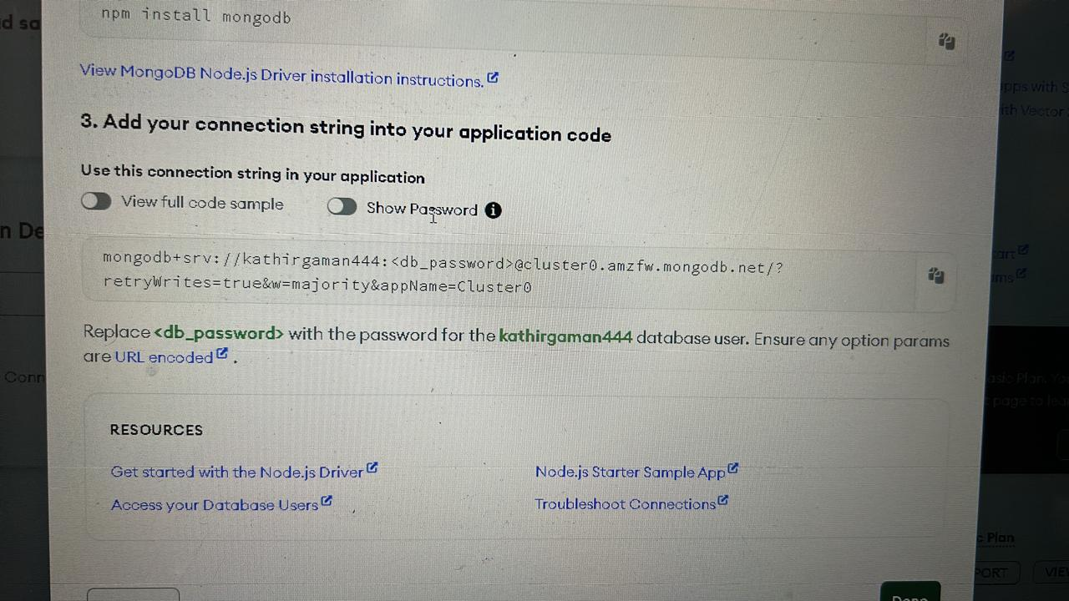
The above image represents the connection string which connects the database and the server.
The <db_password> contains the password for the string.
The server and database will not connect without this password and it is a unique code for every connection.

Slide 34
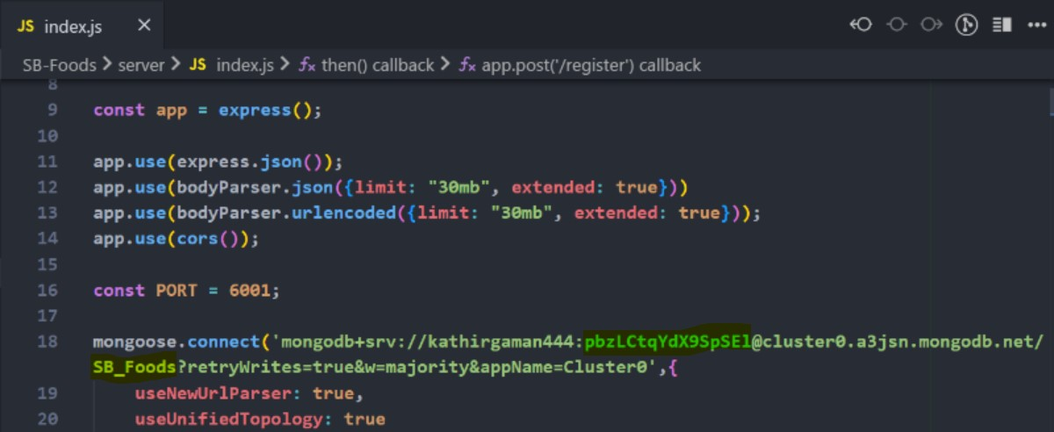
The dB password is highlighted in green and dB name is highlighted yellow in this picture.

Slide 35
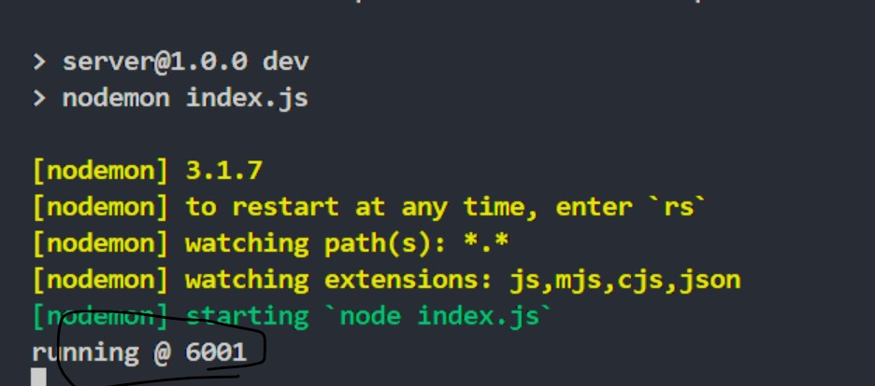

Starting node for index.js
Connected

Slide 36
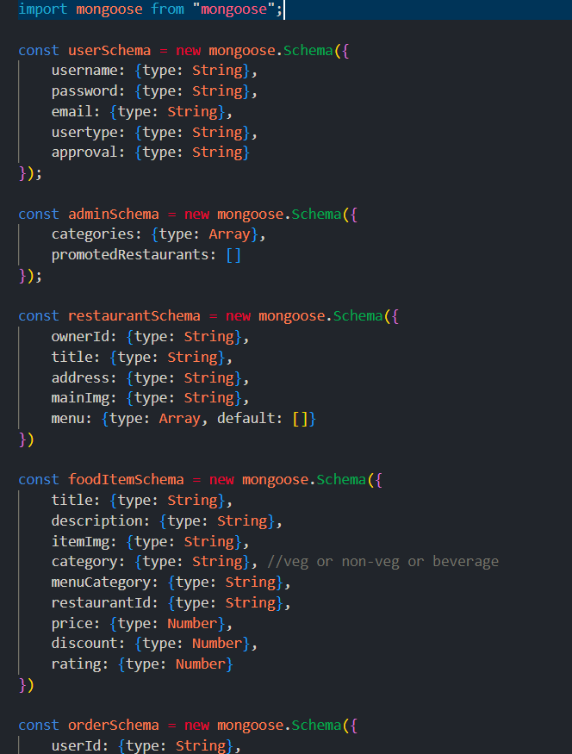
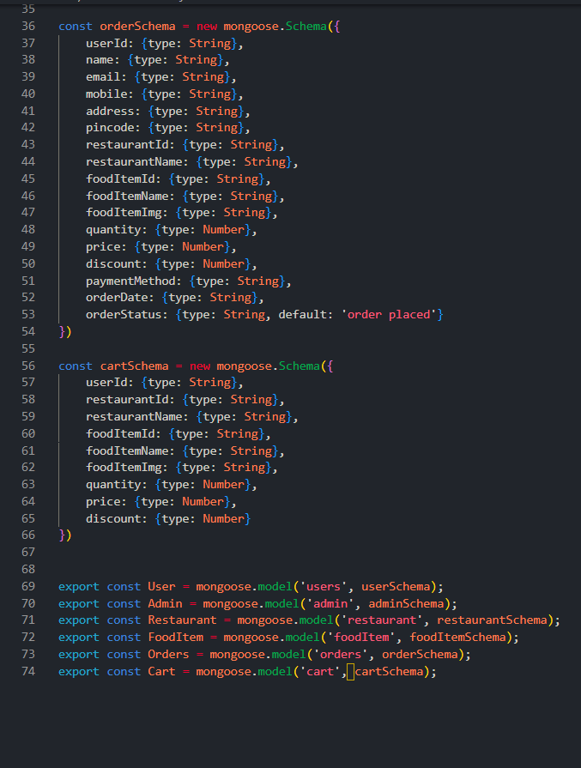
schema.js

Slide 37
Now let’s understand the database of the Application
1. Purpose of the Code
Implements MongoDB schema design for a food ordering system using Mongoose.
Defines the structure of collections like Users, Admins, Restaurants, Food Items, Orders, and Cart.
2. Key Features
User Schema
Models users with fields like:
username, password, email, user type (e.g., admin/customer).
approval: Tracks account approval status.
Admin Schema
Contains:
categories: Categories managed by the admin.
promotedRestaurants: List of promoted restaurants.
Restaurant Schema
Captures restaurant details:
ownerId, title, address, mainImg.
menu: Array of associated food items.

Slide 38
Food Item Schema
Defines menu items with attributes:
title, description, category (e.g., veg/non-veg), price, discount.
Linked to restaurantId for ownership and ratings.
Order Schema
Tracks user orders with details:
User: userId, name, email, address.
Food Item: foodItemId, quantity, price, discount.
orderStatus: Defaults to 'order placed'.
Cart Schema
Temporary storage for user's selected items:
User and restaurant info (userId, restaurantId).
Food item info (foodItemId, quantity, price, discount).
3. Advantages of Using Mongoose
Schema Enforcement: Ensures data consistency across collections.
Simplified CRUD Operations: Mongoose models provide easy interaction with the database.
Default Values: For fields like menu and orderStatus.

Slide 39
4. Models for Interaction
Created using mongoose.model for the collections:
User, Admin, Restaurant, FoodItem, Orders, and Cart.
These models provide functionality for database operations like querying, updating, and deleting documents.
5. System Components Overview
Users: Register and manage their accounts.
Admins: Manage categories and promote restaurants.
Restaurants: Store details and menu items.
Food Items: Associated with restaurants.
Orders: Store order history and status.
Cart: Temporary storage for customer-selected items.

Slide 40
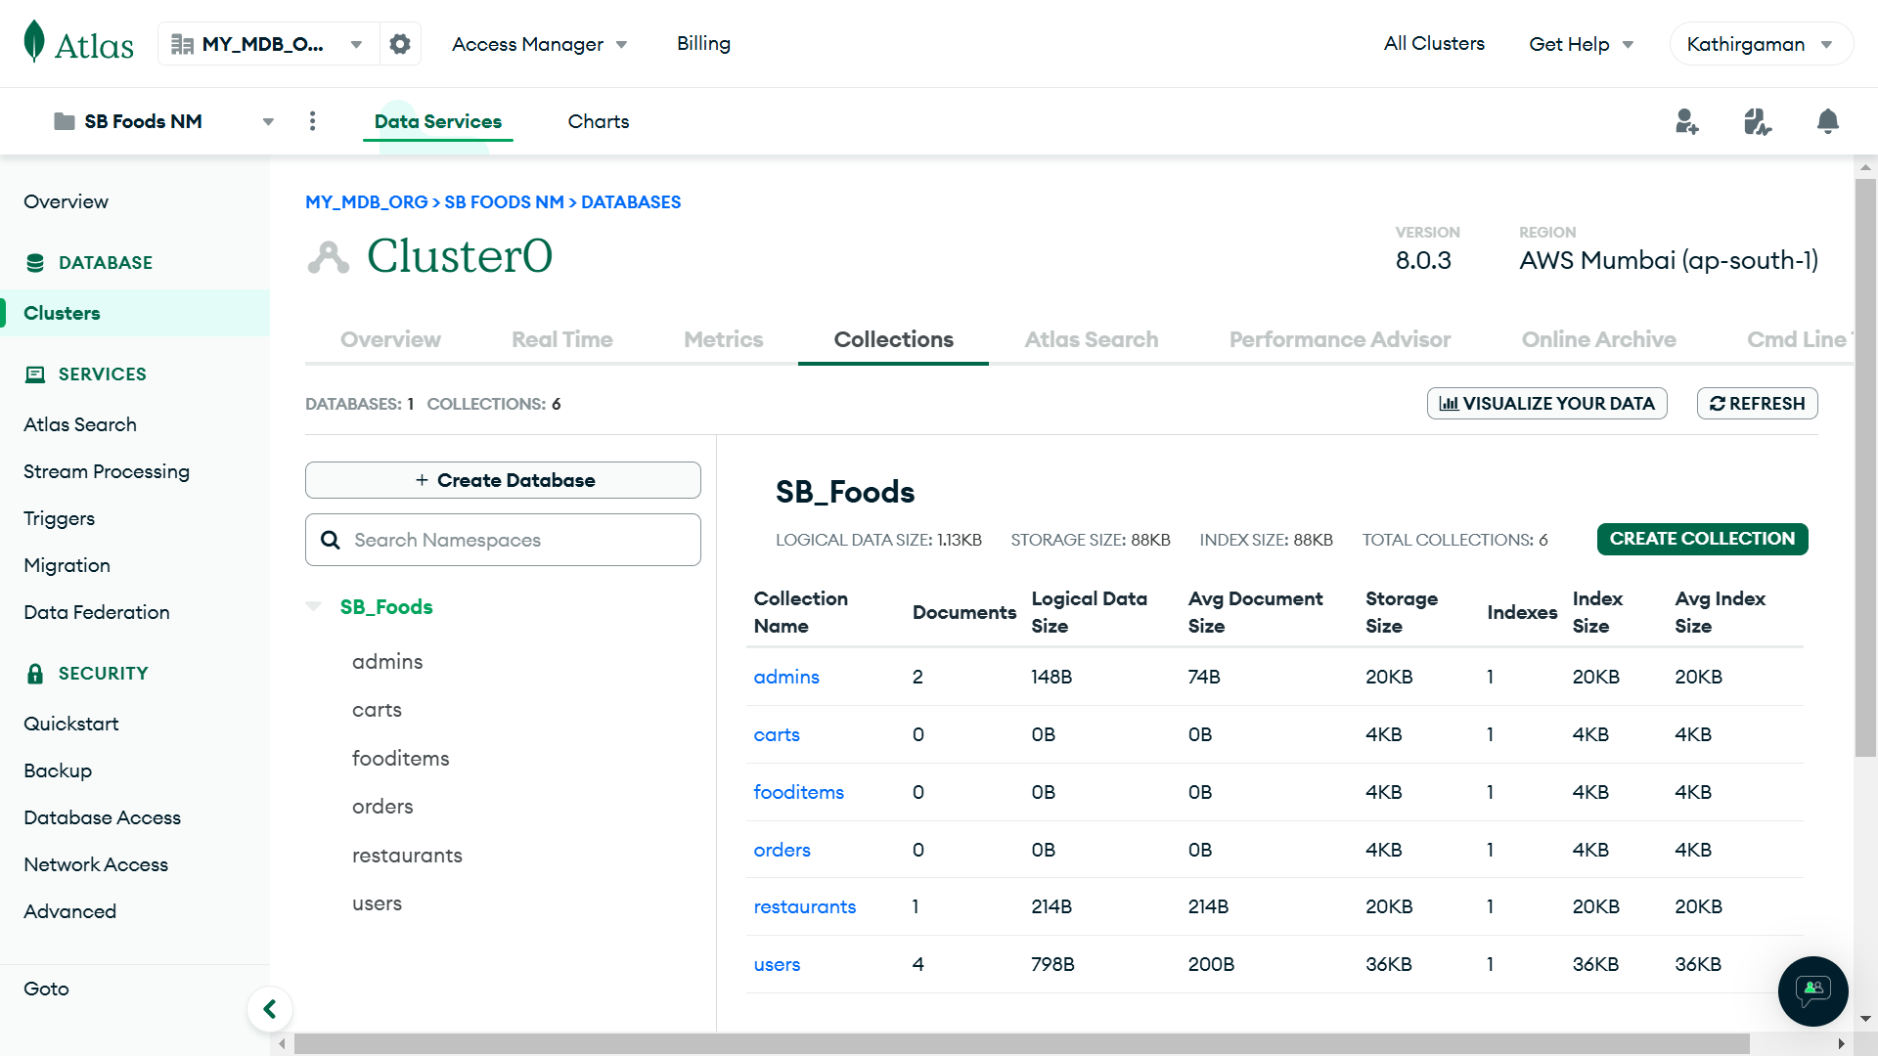
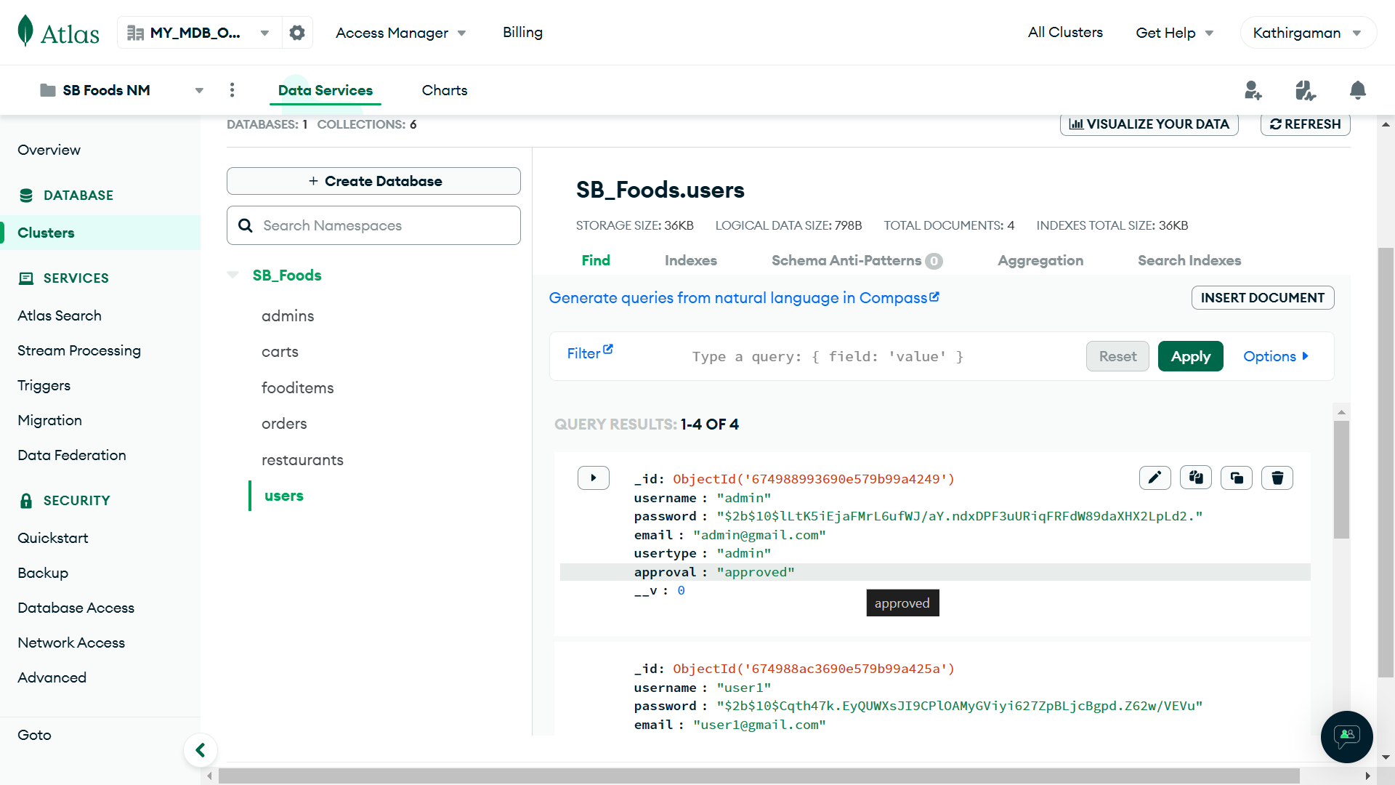
Collections
Data Base Collections
Sample Collections

Slide 41


Testing tool
Jest
This comprehensive testing framework is widely used with React applications, providing a powerful combination of assertion, mocking, and snapshot testing.
Jest offers efficient test running, built-in mocking capabilities for functions and modules, and detailed test result outputs, which are critical for React component testing.

Slide 42

Testing Strategy
Unit Testing:
Objective: Test individual units such as functions, components, and services to ensure they behave correctly in isolation.
Key Activities:
Testing React Components: Verify that React components render correctly given a set of props or state changes.
Function Validation: Test utility functions, input validation, business logic, and transformations, ensuring expected outcomes for various inputs.
Mocking: Employ Jest’s mock functions to simulate dependent services, APIs, or module behaviours during testing.

Slide 43
How’s Testing done for the Application
The provided test code for your food ordering app is checking if a specific text, learn react, is rendered in the application. However, in your App.js, there is no content related to "learn react" being rendered. To make the test relevant and properly implemented for your application, you should:
1. Update the test to reflect the actual structure or content of your application.
2. Ensure the text or elements you are testing for actually exist in your rendered App.js components.

Slide 44
Adjusted Test
import { render, screen } from '@testing-library/react';
import { BrowserRouter } from 'react-router-dom'; // Needed for routing
import App from './App';
test('renders Navbar component', () => {
render(
<BrowserRouter>
<App />
</BrowserRouter>
);
// Test if Navbar is rendered
const navbarElement = screen.getByText(/Home/i); // Adjust the text to something in your Navbar
expect(navbarElement).toBeInTheDocument();
});
test('renders the Home page by default', () => {
render(
<BrowserRouter>
<App />
</BrowserRouter>
);
// Test if the Home component is rendered by default
const homePageElement = screen.getByText(/Welcome/i); // Replace "Welcome" with a recognizable text in your Home page
expect(homePageElement).toBeInTheDocument();
});

Slide 45
Explanation:
1. Routing with BrowserRouter: Since your app uses react-router-dom for routing, the test needs to wrap App in a BrowserRouter to simulate navigation.
2. Text Matching: Replace /Home/i or /Welcome/i with actual text or elements rendered by your Navbar or Home component. These matchers should target real visible content in your application.
3. Component Testing: If your Home or Navbar components render specific text (like "Welcome to our app" or "Cart"), you can test for that text.
Adding Relevant Content for Testing
If App.js lacks a default rendered page or content, you might consider adding a default route (like /) with some text:
Updated App.js
import { Route, Routes } from 'react-router-dom';
import './App.css';
import Navbar from './components/Navbar';
import Home from './pages/Home';
// other imports...

Slide 46
function App() {
return (
<div className="App">
<Navbar />
<Routes>
<Route path="/" element={<Home />} /> {/* Default Home Route */}
<Route path="/auth" element={<Authentication />} />
<Route path="/cart" element={<Cart />} />
{/* Other Routes */}
</Routes>
</div>
);
}
export default App;
Test Results
When you run the updated test, it will verify:
Whether the Navbar renders correctly.
Whether the Home page is the default content when no specific route is selected.
This ensures your tests align with your app's actual functionality.

Slide 47

“As Thomas Alva Edison has tried 1000 to 10,000 times to build a light bulb, we tried 4 times (i.e. solved 4 mistakes)to create and make our app work. So, let’s see the technical issues faced by us”

Slide 48

Technical Issues
State Management:
Managing and synchronizing application state across numerous components, especially in large applications, can be difficult due to prop drilling and maintaining UI consistency.
2. Database Schema Complexity:
Structuring complex data relationships, such as one-to-many or many-to-many, within MongoDB requires thoughtful modelling.
Nesting documents can lead to large data sizes, while referencing can cause slower joins.
3. Handling Edge Cases:
Scenarios such as user input validation, unexpected API response errors, race conditions, server outages, and invalid data can lead to application crashes or poor user experience.
4. API Design:
Ensuring scalable, secure, and maintainable API design is crucial for the backend architecture in Node.js/Express.

Slide 49


Future Improvements
Location-Based Services:
This feature will enable the app to provide personalized recommendations based on the user’s geographical location. By utilizing GPS, the app can suggest nearby restaurants, special offers, and delivery options, ensuring a more relevant and efficient food ordering experience.
2. Real-Time Order Tracking:
Users will be able to track their orders from the moment they place them until they are delivered. With real-time updates on the order’s status, including preparation and delivery stages, customers will have more transparency, leading to greater satisfaction and trust.
3. Credit Points and Discounts:
To enhance customer loyalty, the app will introduce a system where users can earn credit points with each order. These points can be redeemed for discounts on future purchases, providing an incentive to order more frequently while saving money.

Slide 50

Thank you!

